Slide 1
GPR Measurement Point Selection Strategy Analysis
Synthetic & Case Study Evaluation Results

Slide 2
Table of contents
1 Synthetic Evaluation
6 Agenda/Topic
2 Case Study Evaluation
7 Agenda/Topic
3 Agenda/Topic
8 Agenda/Topic
4 Agenda/Topic
9 Agenda/Topic
5 Agenda/Topic
10 Agenda/Topic

Slide 3
Synthetic Evaluation

Slide 4
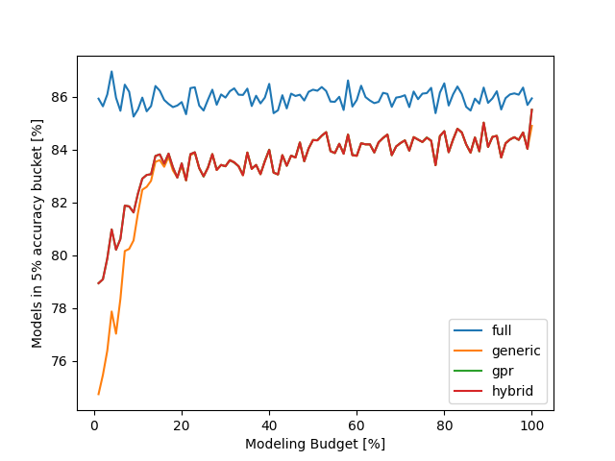
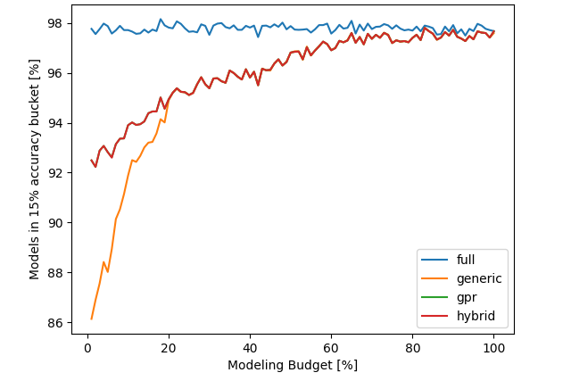
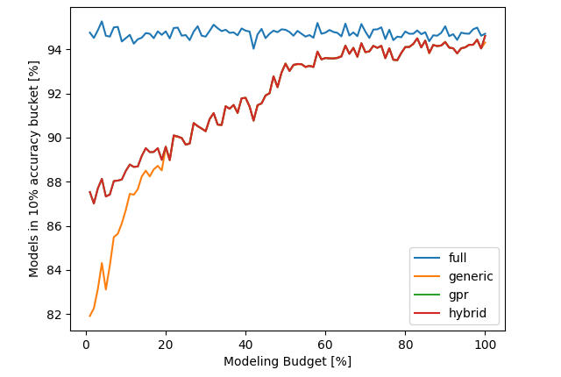
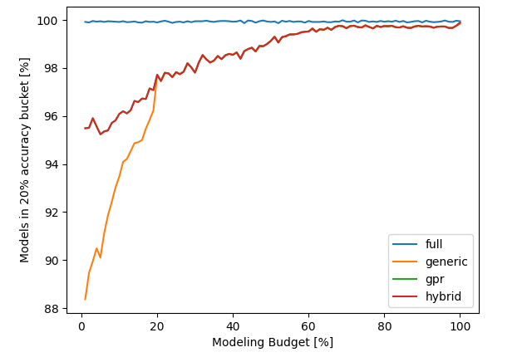
Synthetic Evaluation 2 Model Parameter & 1% Noise
5% Accuracy Bucket
10% Accuracy Bucket
Can be explained by overfitting, less points can lead to a better preditiction on the evaluation point
10% Accuracy Bucket

